Slide 1





Spotify Clone – A Music Player
Team Members:
ANKIT TRIPATHI(2101610109005)
SONAM SRIVASTAVA(2101610109025)
REETIKA SRIVASTAVA(2001610100165)
EKATA RAI(2001610100082) Guide: Mr. Hrishikesh Mahure
Disclaimer: The content is curated for educational purposes only.

Slide 2
OUTLINE
Abstract
Problem Statement
Aims, Objective & Proposed System/Solution
System Design/Architecture
System Development Approach (Technology Used)
Algorithm & Deployment
Conclusion
Future Scope
References
Video of the Project
Notes:
These are the list of chapters that we are going to cover in these foundation codes. Those are chapter one what are AI and ML? chapter 2 applied Python programming in AI, and chapter 3 is exploratory data analysis for ML.

Slide 3
Abstract The Spotify clone is a web-based music player created using HTML, CSS, and JavaScript. The user interface replicates the sleek design of Spotify, offering an immersive experience for music enthusiasts. The HTML structure defines the layout, while CSS stylizes the elements to mirror Spotify's aesthetic. JavaScript handles dynamic functionalities, allowing users to play, pause, skip tracks, and adjust volume seamlessly. The clone utilizes APIs for fetching and displaying music data, ensuring a diverse and up-to-date library. Overall, this project aims to provide a user-friendly and visually appealing platform for music streaming enthusiasts, emulating the core features of the popular Spotify application.

Slide 4
Problem Statement In the rapidly evolving landscape of music streaming services, there is a growing demand for personalized and feature-rich platforms that offer a seamless user experience. Developing a Spotify clone aims to address several key challenges and requirements within this domain:​ ​ 1. Performance and Scalability​ 2. Discovery and recommendation​ 3. User Interface and Experience​ 4. Offline mode​ 5. Artist and listener Interaction​

Slide 5
Aim and Objective Aim:​ The aim of the Spotify clone project is to develop a user-centric music streaming platform with advanced customization, seamless cross-platform accessibility, intelligent recommendations, and collaborative features, providing a personalized and engaging experience for users while adhering to legal a licensing consideration.​ ​ Objectives: ​ To maintain its performance and scalability.​ Offline mode and cross-platform compatibility in any devices.​ Ensure to user data integrity and security.​ To Enhance Personalization.​

Slide 6
Proposed Solution 1. Frontend(For UI/UX and Cross Platform access): 1. Html : HTML allows users to create and structure sections, headings, links, paragraphs, and more, on a website using various tags and elements. Almost everything you want to create on a web page can be done using a specific HTML code. In our project we use Html mainly for structuring of its contents and elements. 2. CSS : CSS is used for defining the styles for web pages. It describes the look and formatting of a document which is written in a markup language. It provides an additional feature to HTML. It is generally used with HTML to change the style of web pages and user interfaces. 3. Javascript: JavaScript (JS) is a cross-platform, object-oriented programming language used by developers to make web pages interactive. It allows developers to create dynamically updating content, use animations, pop-up menus, clickable buttons, control multimedia, etc. 4. ReactJS : React is a library for building composable user interfaces. It encourages the creation of reusable UI components that present data that changes over time. React is a powerful JavaScript UI library for creating modern applications.

Slide 7
Features: User Authentication Pages: Sign up, log in, and user account settings. Home Page: Display recommended playlists, new releases, etc. Search Page: Implement a search bar to look for songs, artists, and albums. Playlist Page: Display individual playlists with the ability to play songs. Audio Player Component: A persistent component that allows users to control playback. 2. Spotify API (optional): Integrate the Spotify API to fetch real-time data such as song information, cover art, and user playlists. 3. Security: Implement secure authentication practices, and ensure data privacy. 4. Scalability: Design the architecture to handle a growing number of users and songs. 5. Performance: Optimize the application for fast loading and smooth user experience. 6.Testing: Perform unit testing, integration testing, and end-to-end testing to ensure the application's reliability.

Slide 8
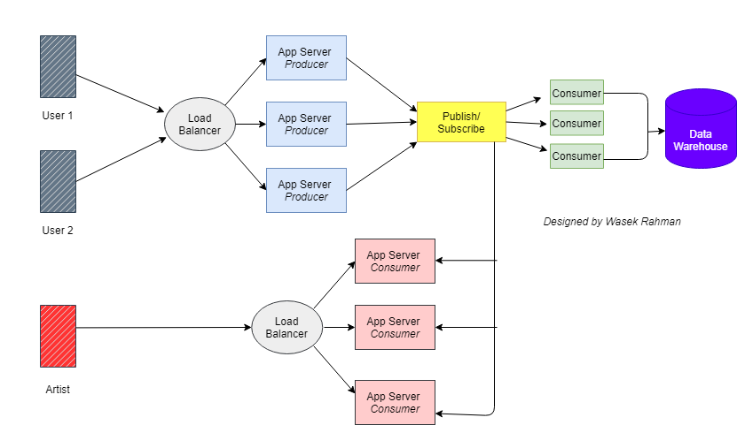
System Architecture

Slide 9
System Deployment Approach
Make a Github Repo.
Upload all the files in Github desktop
Then, Deploy all files in master branch of the Repo.
Then, Finally we get a link at Githuh Pages and Deployment has been successful.

Slide 10
Algorithm & Deployment SDLC(Software Development Life Cycle) for this Project– 1. Planning : We make a proper plan like cost-benefit analysis, scheduling, resource estimation, and allocation. 2. Designing: For the designing purpose of project, we made a layout of our Project on Figma. 3. Implementation/Coding : A) Frontend: For good UI/UX of our project, we used Html, CSS, Javascript and RectJs. B) Backend : For fetching of Data from server we used NodeJs. C) Database: For the database of our software we used MySQL. 4. Testing : For testing, we did Unit testing then Integration testing and finally we did System Testing. 5. Deployment : We deploy our Project website on Github Pages.

Slide 11
Conclusion In summary, developing a Spotify clone involves building a backend server using technologies like Node.js or Django, incorporating features like user authentication, playlist management, and song streaming. The frontend, created with React or Vue.js, should include pages for user authentication, home, search, and playlists, along with an audio player component. Integrations such as the Spotify API and optional payment gateways enhance the user experience. Considerations for security, scalability, performance, and comprehensive testing are crucial. Documentation, deployment on cloud platforms, and legal compliance ensure a successful and user-friendly music streaming application.

Slide 12
Future Scope The future scope of a Spotify clone can extend in various directions, driven by technological advancements, market trends, and user expectations. Here are some potential areas for future development: Enhanced Recommendation Algorithms: Invest in machine learning and AI algorithms to improve personalized music recommendations based on user preferences, behavior, and context. Podcasting Integration: Integrate podcast streaming capabilities to cater to the growing demand for podcasts and audio content, providing users with a broader range of audio entertainment. Social Features: Expand social features, allowing users to connect with friends, share playlists collaboratively, and discover music based on the preferences of their social network. Virtual Reality (VR) and Augmented Reality (AR) Integration: Explore immersive technologies like VR and AR to create unique and interactive music experiences, such as virtual concert simulations or AR-enhanced album covers. Blockchain for Royalties and Copyright Management: Implement blockchain technology to address royalty and copyright management issues, ensuring fair compensation for artists and content creators while maintaining transparency. Offline and Limited Connectivity Improvements: Enhance offline mode capabilities for users in regions with limited connectivity, allowing them to enjoy uninterrupted music streaming experiences.

Slide 13
Reference
https://www.w3schools.com/
https://github.com/
https://www.geeksforgeeks.org/
https://chat.openai.com/
https://developer.mozilla.org/en-US/docs/Learn
Notes:
Reference
These are the references for this session.
13

Slide 14
Thank you!
Notes:
thank you very much for joining this PPT, keep learning.
14

